Slide 1

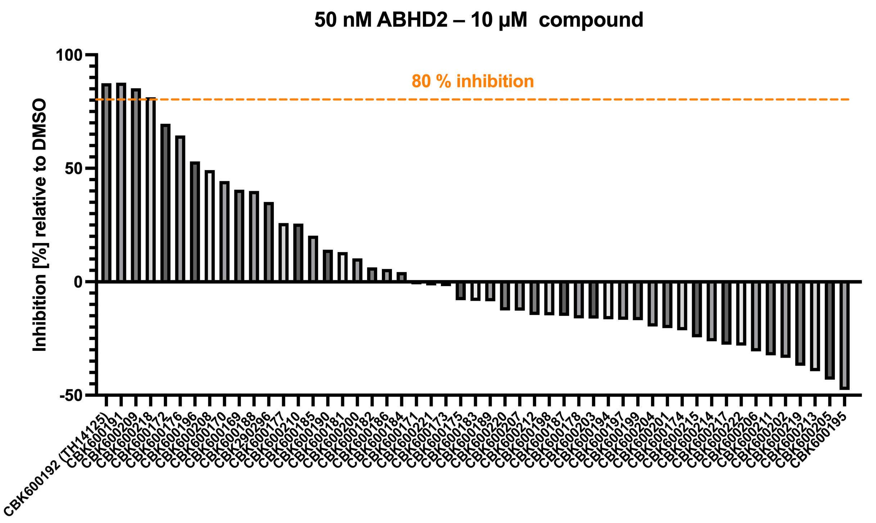
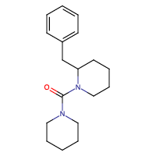
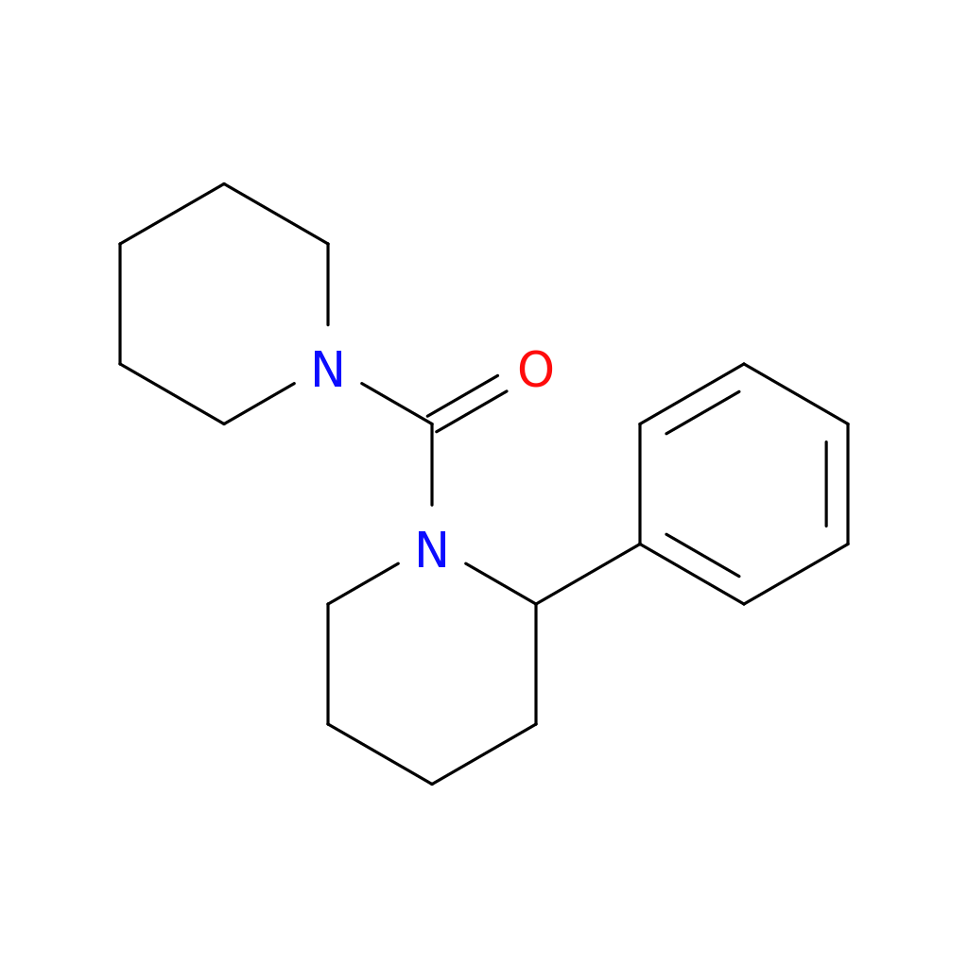
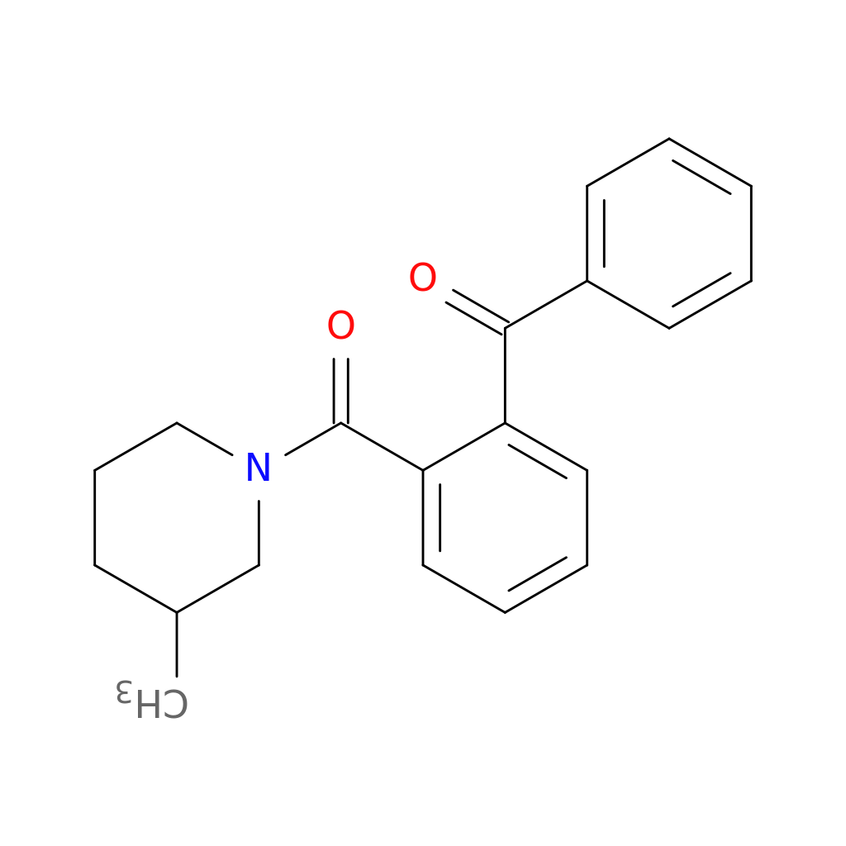
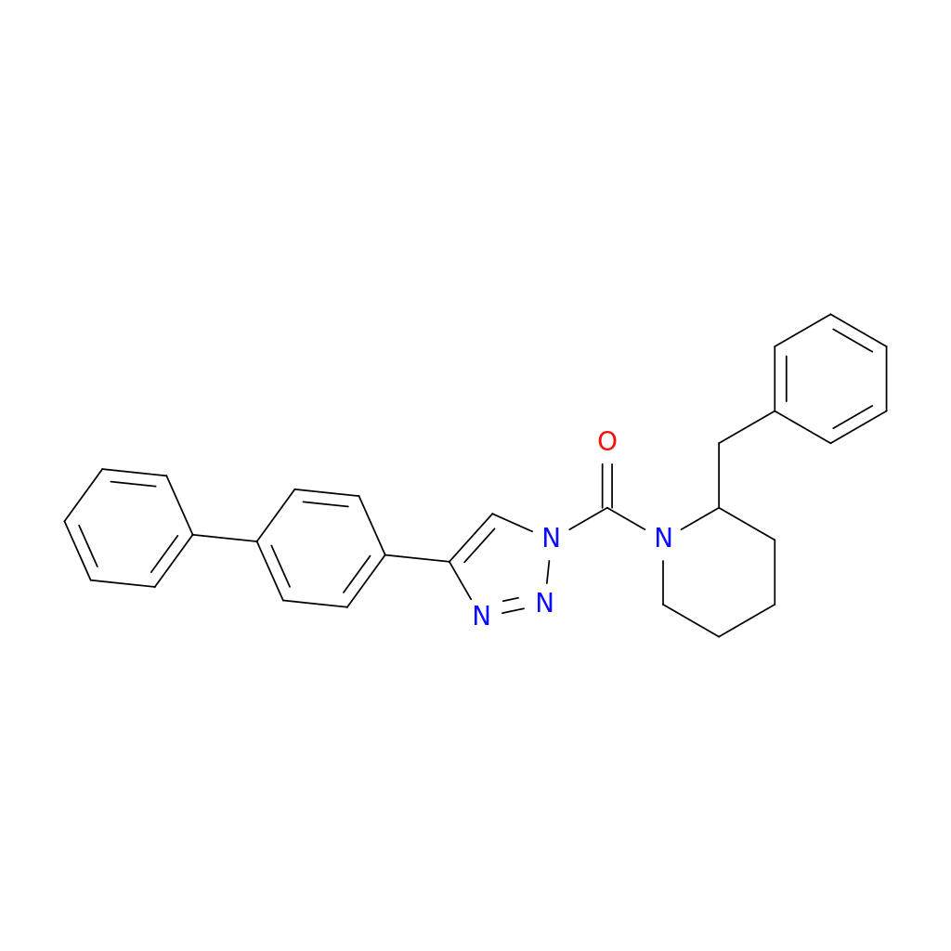

ABHD2 – Compounds – TH14125 derivatives
53 derivatives at single concentration measured in triplicates
30 min pre-incubation on ice with compound
Assay at 37 ºC for 20 min with 500 µM pNP octanoate
3 hits with similar potency as TH14125
→ Next: dose-response and validation
TH14125 – ABHD2i
Baggelaar et al., ACS, 2019
CBK600191
CBK600209
CBK600218

